Slide 1
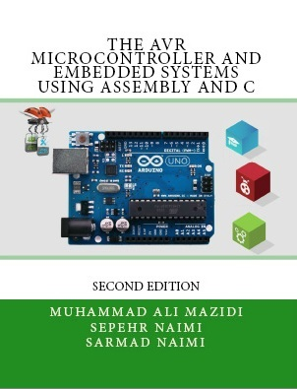

SPI Protocol
Sepehr Naimi
www.NicerLand.com

Slide 2
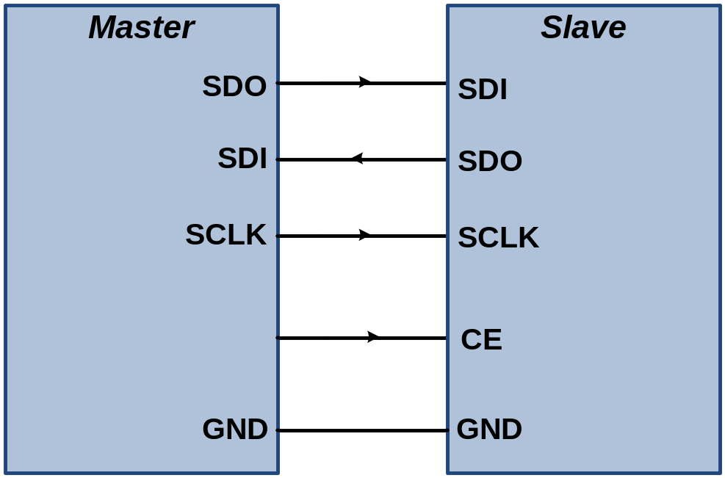
SPI Protocol
Synchronous
Full-duplex
Serial
Fast communication
For short distances
Pins
  SDO (Data Out)
  SDI (Data In)
  SCLK (shift clock)
  CE (chip enable)

Slide 3
Master vs. Slave
Master begins the communication by pulling down the CE pin of slave.
Master makes the clock for communication

Slide 4
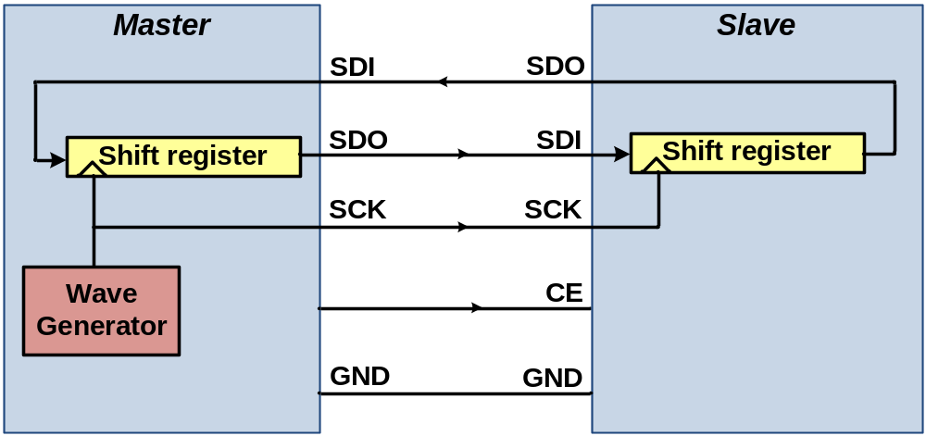
SPI internal circuit
A shift register in the master and another in the slave
By each clock, a bit is shifted out from the master’s shift register into the slave shift register and a bit is shifted from slave to master.

Slide 5
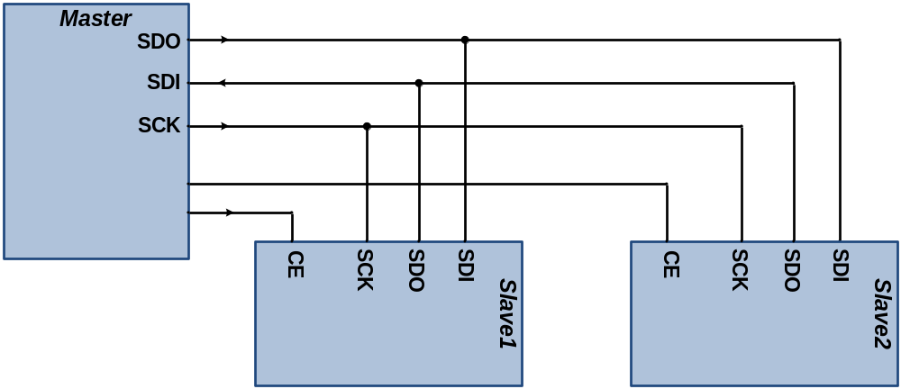
Multi-slave communication

Slide 6
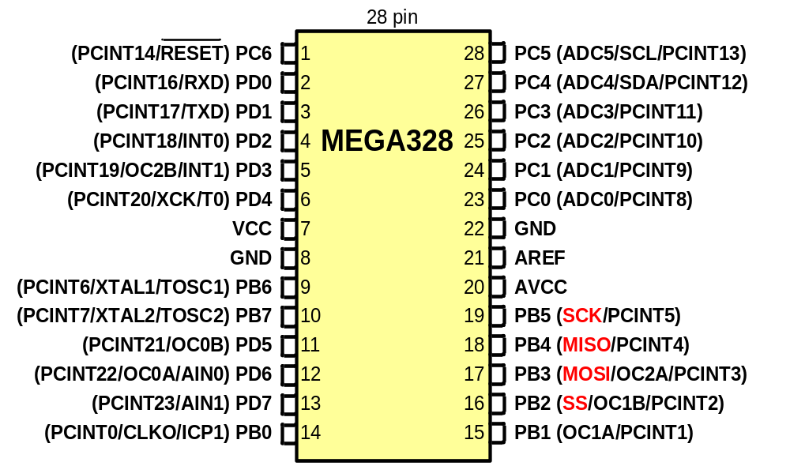
SPI pins in AVR
MOSI (Master Out Slave In)
MISO (Master In Slave Out)
SCK
SS

Slide 7
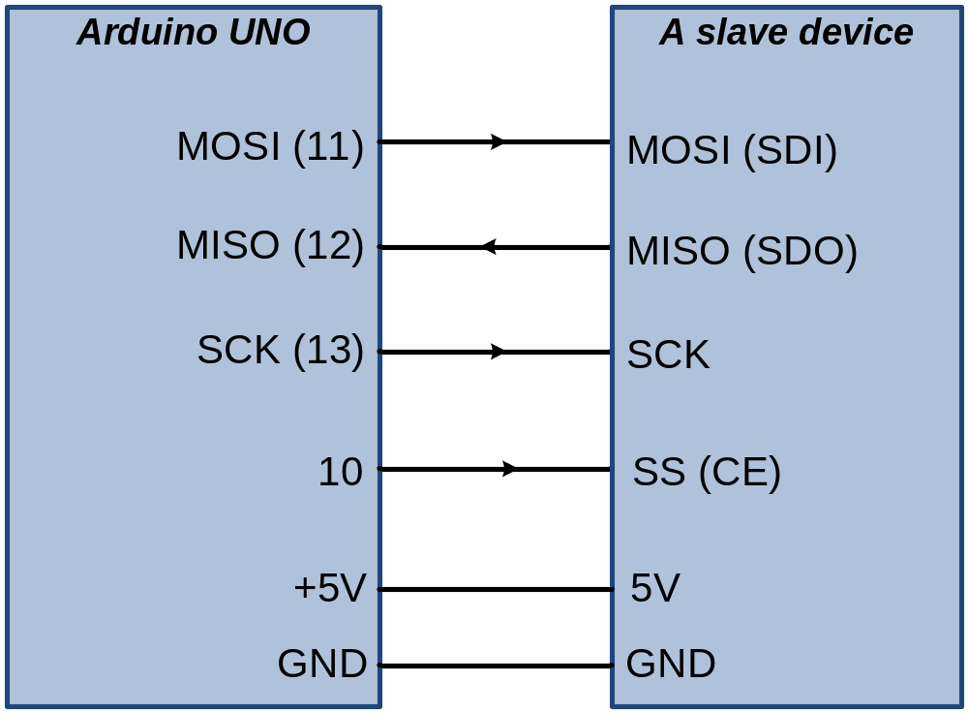
Connecting a slave device to an AVR

Slide 8
AVR registers
Control register:
  SPCR (SPI Control Register)
Status Register:
  SPSR (SPI Status Register)
Data Register:
  SPDR (SPI Data Register)

Slide 9
SPSR (SPI Status Register)
SPIF (SPI Interrupt Flag)
  A serial transfer is completed.
  The SS pin is driven low in slave mode
WCOL (Write Collision)
SPI2X (Double SPI Speed)

Slide 10
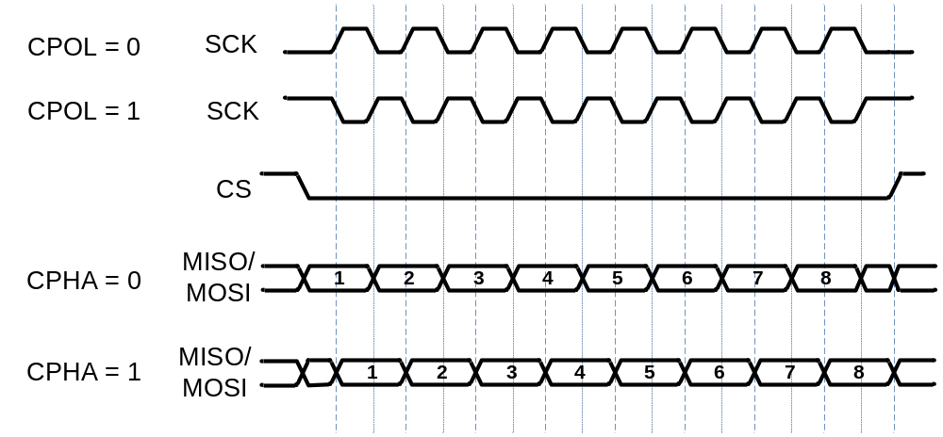
SPCR
CPOL | CPHA | Data Read and Change Time | SPI Mode
0 | 0 | Read on rising edge, changed on a falling edge | 0
0 | 1 | Read on falling edge, changed on a rising edge | 1
1 | 0 | Read on falling edge, changed on a rising edge | 2
1 | 1 | Read on rising edge, changed on a falling edge | 3
SPIE (SPI Interrupt Enable)
SPE (SPI Enable)
DORD (Data Order)
MSTR (Master)
CPOL (Clock Polarity)
CPHA (Clock Phase)
SPR1, SPR0 :SPI Clock Rate
SPI2X | SPR1 | SPR0 | SCK Freq.
0 | 0 | 0 | Fosc/4
0 | 0 | 1 | Fosc/16
0 | 1 | 0 | Fosc/64
0 | 1 | 1 | Fosc/128
1 | 0 | 0 | Fosc/2 (not recommended)
1 | 0 | 1 | Fosc/8
1 | 1 | 0 | Fosc/32
1 | 1 | 1 | Fosc/64

Slide 11
Program 1: Sending ‘G’ through SPI as a master
#include <avr/io.h>
#define MOSI 3
#define SCK 5
#define SS 2
int main (void)
{
DDRB = (1<<MOSI)|(1<<SCK)|(1<<SS); //MOSI and SCK are output
DDRD = 0xFF; //Port D is output
SPCR = (1<<SPE)|(1<<MSTR)|(1<<SPR0); //enable SPI as master
while(1) //do for ever
{
PORTB &= ~(1<<SS); //enable slave device
SPDR = 'G'; //start transmission
while(!(SPSR & (1<<SPIF))); //wait transfer finish
PORTD = SPDR; //move received data to PORTD
PORTB |= (1<<SS); //disable slave device
}
return 0;
}

Slide 12
Program 2: Sending ‘G’ through SPI as a slave
#include <avr/io.h>
#define MISO 4
int main (void)
{
DDRD = 0xFF; //Port D is output
DDRB = (1<<MISO); //MISO is output
SPCR = (1<<SPE); //enable SPI as slave
while(1)
{
SPDR = 'G';
while(!(SPSR &(1<<SPIF))); //wait for transfer finish
PORTD = SPDR; //move received data to PORTD
}
return 0;
}

